Slide 1
AI for Semantic Web
AI & Robotics for Intelligent Agents
Ubbo Visser
Associate Professor
Distinguished Faculty for Cognitive Science and Aging
Trustee of the RoboCup Federation
Director of Graduate Studies
Department of Computer Science
College of Arts and Sciences
May 2022

Slide 2
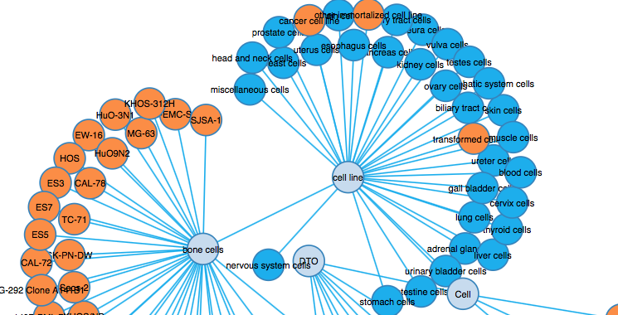
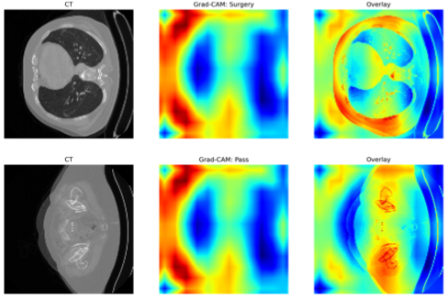
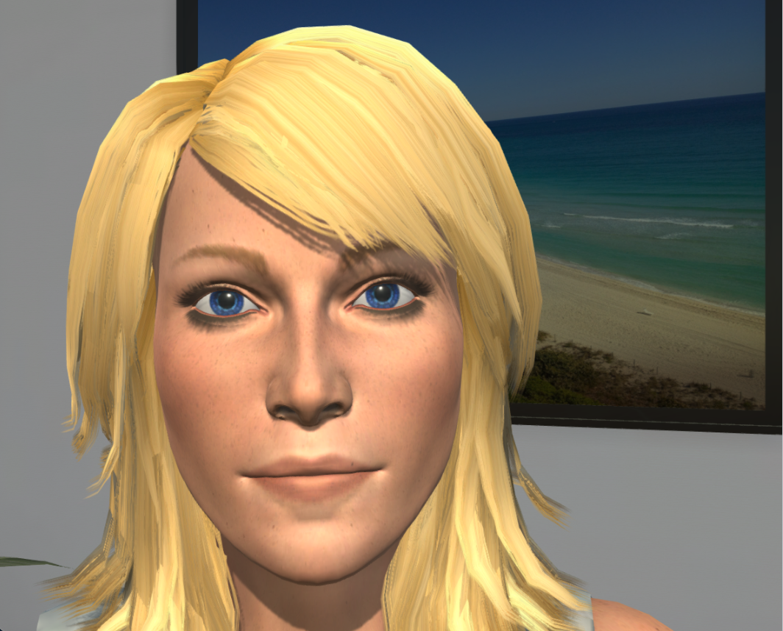
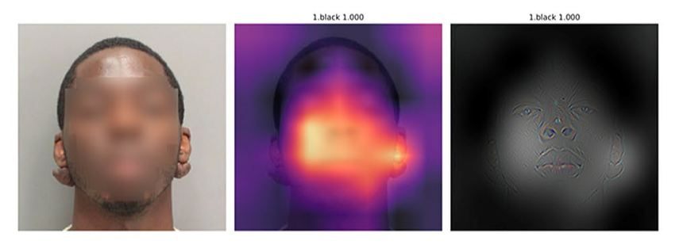
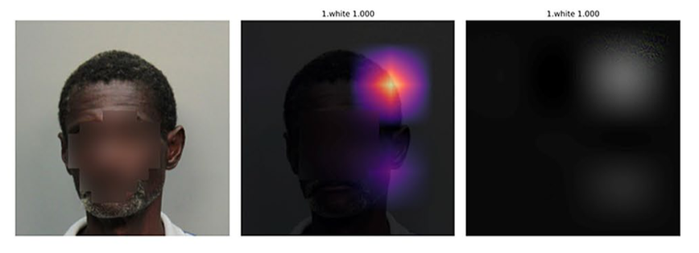
Ontologies, Knowledge Engineering, Semantic Web, Spatio-temporal Reasoning
Ontologies, Knowledge Engineering, Semantic Web, Spatio-temporal Reasoning
Machine Learning, Digital Health, Therapy, FRT

Slide 3
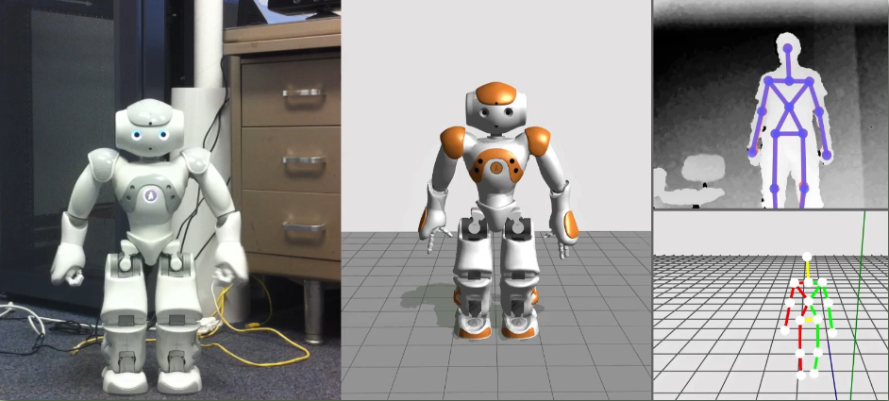
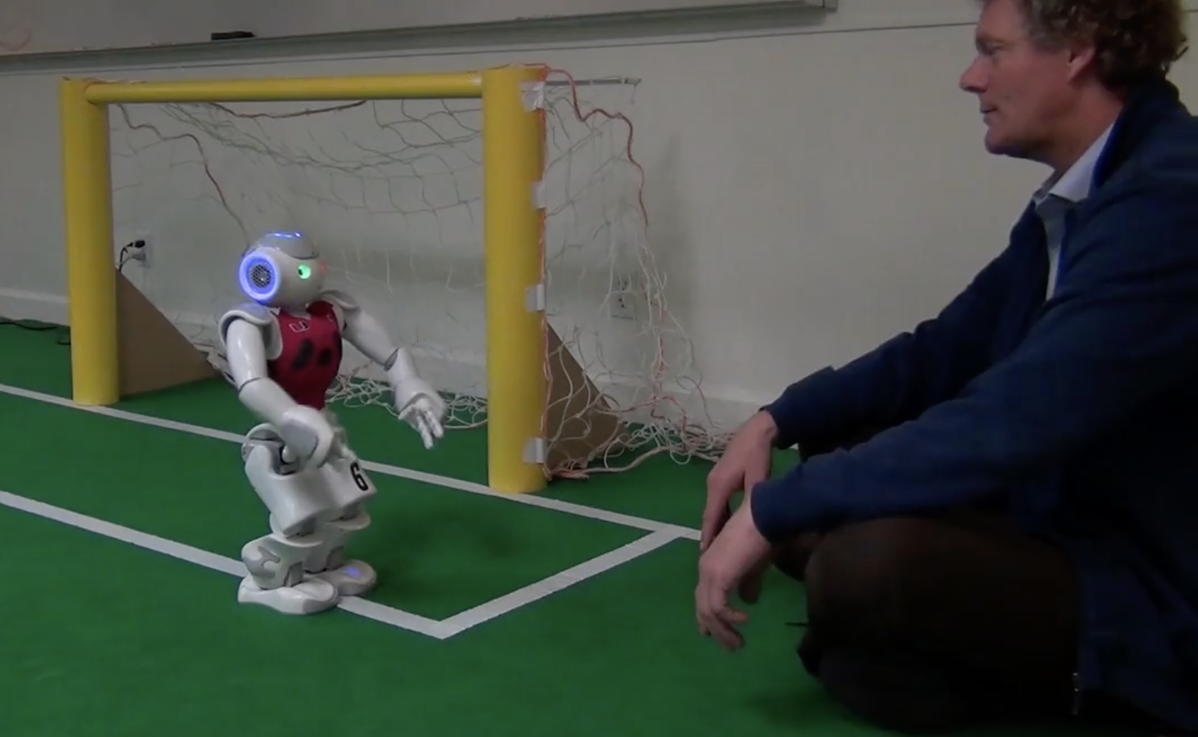
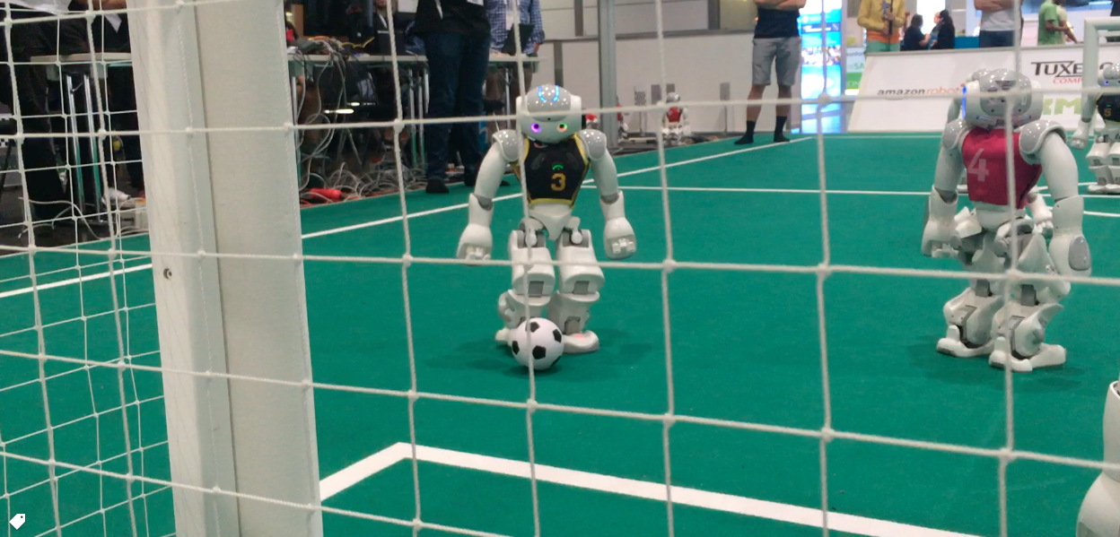
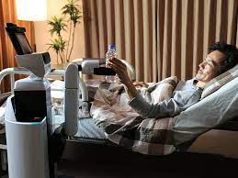
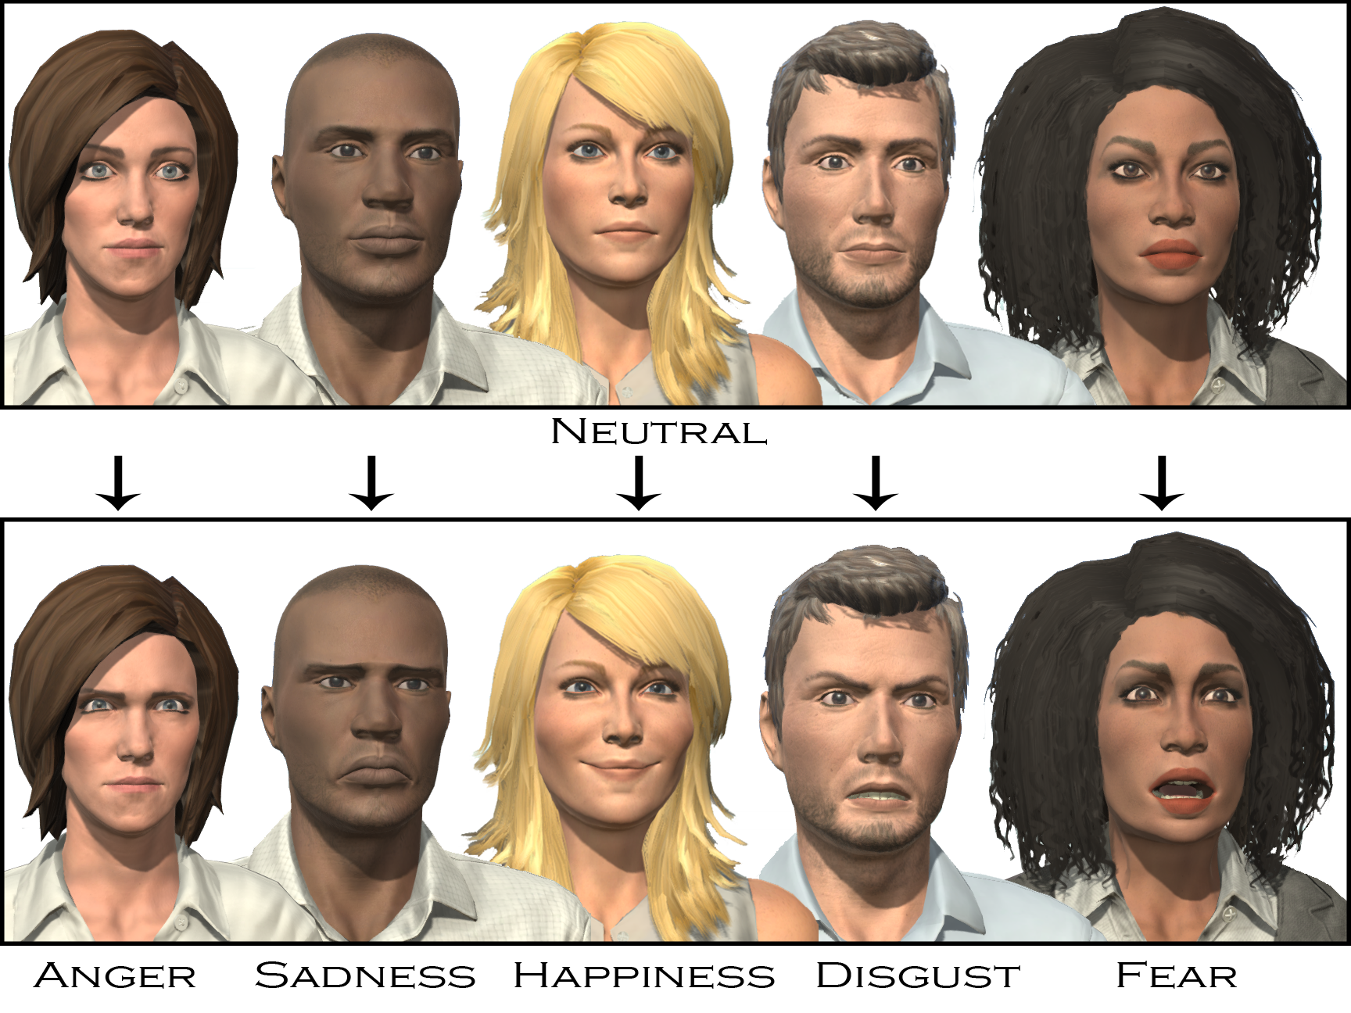
Drive interdisciplinary AI & Robotics research to enable the next generation of robots that work and interact safely alongside humans.

Slide 4
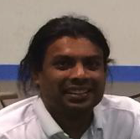
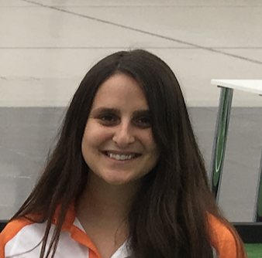
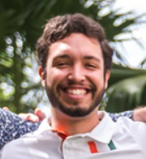
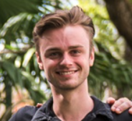
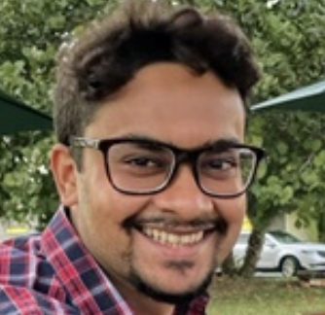
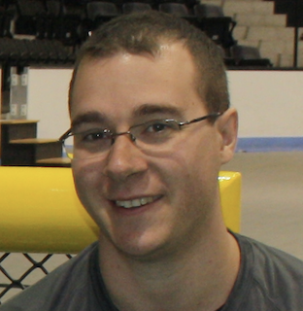
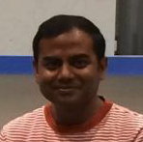
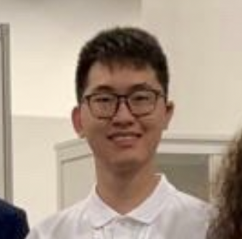
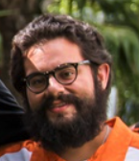
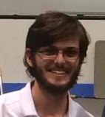
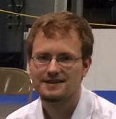
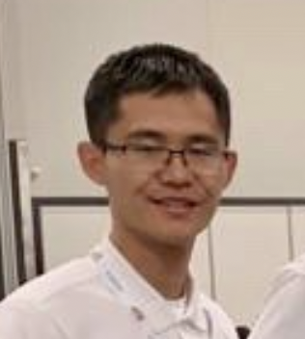
Thank You!
Saminda Abeyruwan
Chloe Arluck
Lloyd Beaufils
Michael Davis
Rahul Dass
Alexander Härtl
Nasir Laskar
Shengxin (Tony)
Luo
Joe Masterjohn
Katarzyna (Kasia) Pasternak
Kyle Poore
Justin Stoecker
Zishi Wu
Phil McKenna
Pedro Peña
Andreas Seekircher
Contact
Web: https://www.cs.miami.edu/~visser
Email: visser@cs.miami.edu

