Slide 1
Sample System Diagrams

Slide 2
STEM CITY

Slide 3
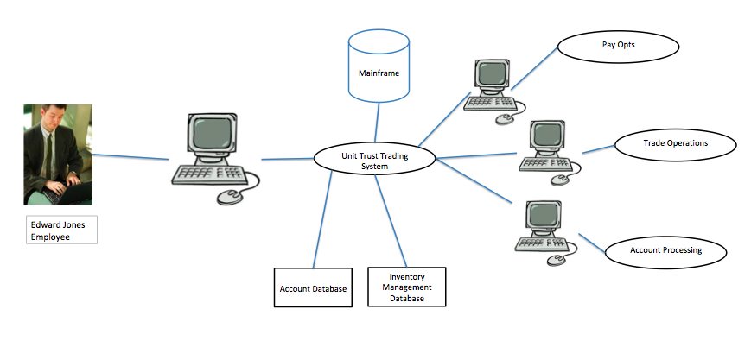
Trading Support

Slide 4
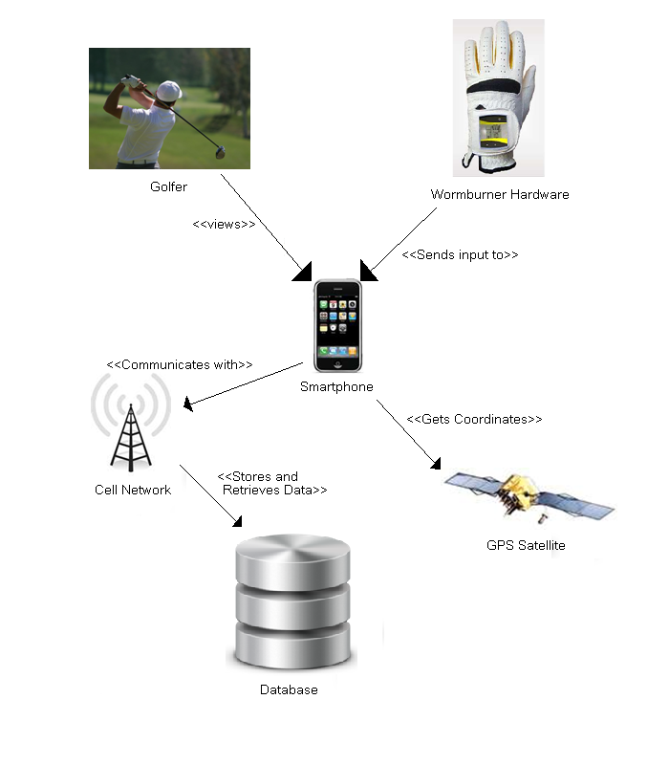
Wormburner

