Slide 1
Tag-Based Language Learning Experience
Iman Saleh
RashidStone

Slide 2
Language Learning Software
RS provides language learning Web-based software solutions
Users of RS are both learners and administrators.
Administrators are typically teachers managing a class of students learning a language
Learners using RS are from different ages, and countries with different cultures

Slide 3
Problem Description
RS needs a way to match learning contents and functionalities with learners to enforce some business rules
Examples:
Some material may not be appropriate for kids under 13 years old
Some functionalities may only be available for teachers but not students, such as generating reports on learners
Asian markets don’t want their learners to access Facebook through RS products

Slide 4
Proposed Solution
RS considers using Tags
Tags are free-text strings that can be used as metadata to describe a user
When accounts for learners and teachers are created, the interface should enable attaching tags to the accounts
The interface should recommend tags based on user attributes
Example: User birth year >= 2000 => Tag = Kid
The interface should minimize duplication of tags

Slide 5
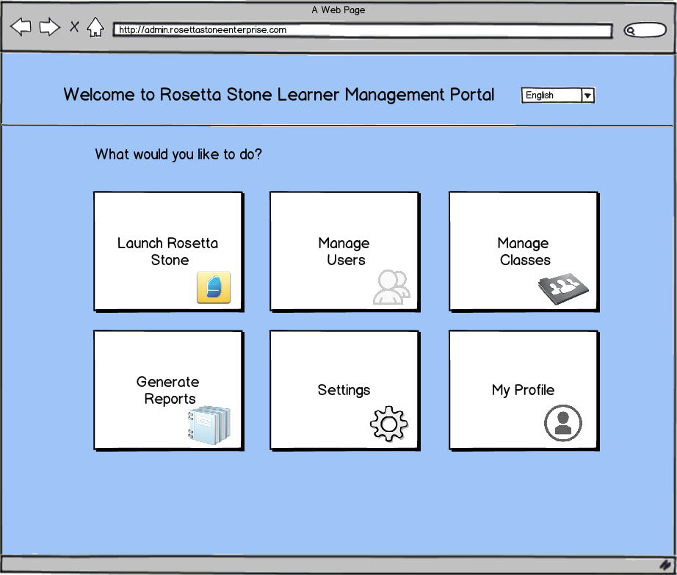
Learner Management Portal
Notes:
Balsamiq Mockup Tool

Slide 6
Deliverables
Full Software engineering design and cost estimation for a production-strength application
Visual mockups of screens and prototype software demonstrating the user creation forms with tags
Timeline and Risks to transition to this new approach and application

