Slide 1
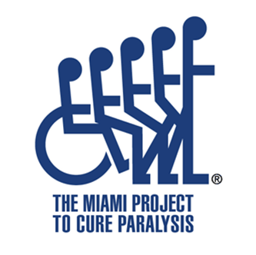
The Effect of the StartReact Response on Gross Hand Function after Spinal Cord Injury
Morgan Rosser^{1,5}, Vance Lemmon^{2,4}, Monica A. Perez^{2,3}
¹Department of Computer Science, Computing for a Structure REU, ²Miami Project to Cure Paralysis, ³Department of Neurosurgery, ⁴Center for Computational Science, ⁵St. Lawrence University

Slide 2
Background
The Reticulospinal Tract consists of 2 different pathways originating from
Pontine reticular formation
Fibers terminate on neurons affecting axial and limb muscles in spinal cord
Activity facilitates voluntary and reflex response/influences muscle tone
Medullary reticular formation
Fibers located in the anterior funiculus and terminate at all levels of the spinal cord
Have inhibitory effect on voluntary and reflex responses of axial and limb muscles (“Descending Pathways”)
Notes:
https://nba.uth.tmc.edu/neuroanatomy/L9/Lab09p33_index.html
The fibers of the pontine reticulospinal tract arise from the pontine reticular formation, remain uncrossed and descend the brainstem in the medial longitudinal fasciculus, of which it forms the major descending component. In the spinal cord, the fibers terminate on neurons affecting axial and limb muscles. Their activity facilitates voluntary and reflex responses and influences muscle tone.
The medullary reticulospinal fibers originate in the medullary reticular formation. The fibers, bilateral, but mainly uncrossed, form an indistinguishable fiber bundle posterior to the inferior olives at the level of the medulla. In the spinal cord, they become located in the anterior funiculus and terminate at all levels of the cord. They have an inhibitory effect on voluntary and reflex responses of axial and limb muscles.

Slide 3
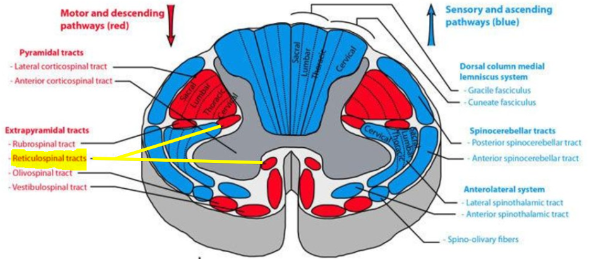
Background
Figure 1. Diagram of Pontine Reticular Formation and Medullary Reticular Formation of the Reticulospinal Tract, taken from Lab 9 - Descending Pathways to the Spinal Cord. (1997). Retrieved June 20, 2018, from https://nba.uth.tmc.edu/neuroanatomy/L9/Lab09p33_index.html

Slide 4
Background
StartReact
Presenting a startling auditory stimulus with an imperative signal in a reaction time task paradigm promotes an acceleration in reaction time (Valls-Sole´ et al. 1995, 1999)
A startling stimulus induces two effects:
Startle response
Acceleration of reaction time (Valls-Sole´ et al. 1995, 1999, 2005)
Shortened reaction time may involve subcortical structures like the reticular formation (Valls-Sole et al., 1999; Carlsen et al., 2003, 2004, 2005)
Notes:
Reticulospinal tract is thought to play a role in recovery of hand function following spinal cord injury (Baker & Perez, 2017).
It is suggested that there is link between reticulospinal outputs and gross finger manipulations after SCI (Baker & Perez, 2017)
Source of information:
The presentation of a startling auditory stimulus together with the imperative signal in a reaction time task paradigm induces a significant acceleration of the reaction time
The most important conclusion from our study is that prepulse stimuli maintain their inhibitory effects over the startle response even during motor preparation for execution of a motor task, while it does not act on the startle-induced reaction time acceleration, or StartReact phenomenon. This suggests that a startling stimulus is capable of inducing two different effects, the startle response and the acceleration of the reaction time, and both seem to be mediated by different neuronal circuits

Slide 5
Background
Baker and Perez (2017) used the StartReact paradigm in humans with spinal cord injury (SCI) while performing grasping manipulations. They demonstrated that the reticulospinal tract contributes to a greater extent to the control of gross versus fine finger manipulations after SCI.
Object of this Experiment: to implement this information, and use a gross hand training protocol paired with the StartReact Paradigm to improve gross hand function by improving reaction time in the FDI.

Slide 6
Methods- Baseline/Post-Testing
Subjects’ dominant hand was tested, subjects were seated with dominant arm bent at 90 degrees
Surface EMGs were placed on the belly of the FDI, APB, and ADM muscles (Figure 3) and recorded using the Spike2 Software
emphasis/attention was focused on the FDI (Figure 4)
Subjects were instructructed to make the movement of squeezing their fist, from a relaxed fisted position, and immediately release and return to the relaxed position (Figure 2)
Movement was cued when a red LED illuminated for 20 ms
VRT: LED only
VART: LED + control sound (80 dB; 500 Hz, 20 ms)
VSRT: LED + Startle sound (115 dB, 500 Hz, 20 ms)
LED was located roughly a meter away from the position of the subject
Sound was delivered using headphones
Notes:
EMG recorded of the FDI, on the subject’s dominant hand, using surface electrodes placed on the belly of the muscle and the Spike computer program
StartReact response was examined for Pre and Post-Testing when subjects performed power grip, which was instructed as making a fist
Subjects performed task when red LED illuminated, the LED flashed either by itself, with a quiet acoustic stimulus, or a startling acoustic stimulus

Slide 7
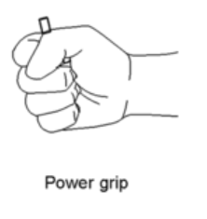
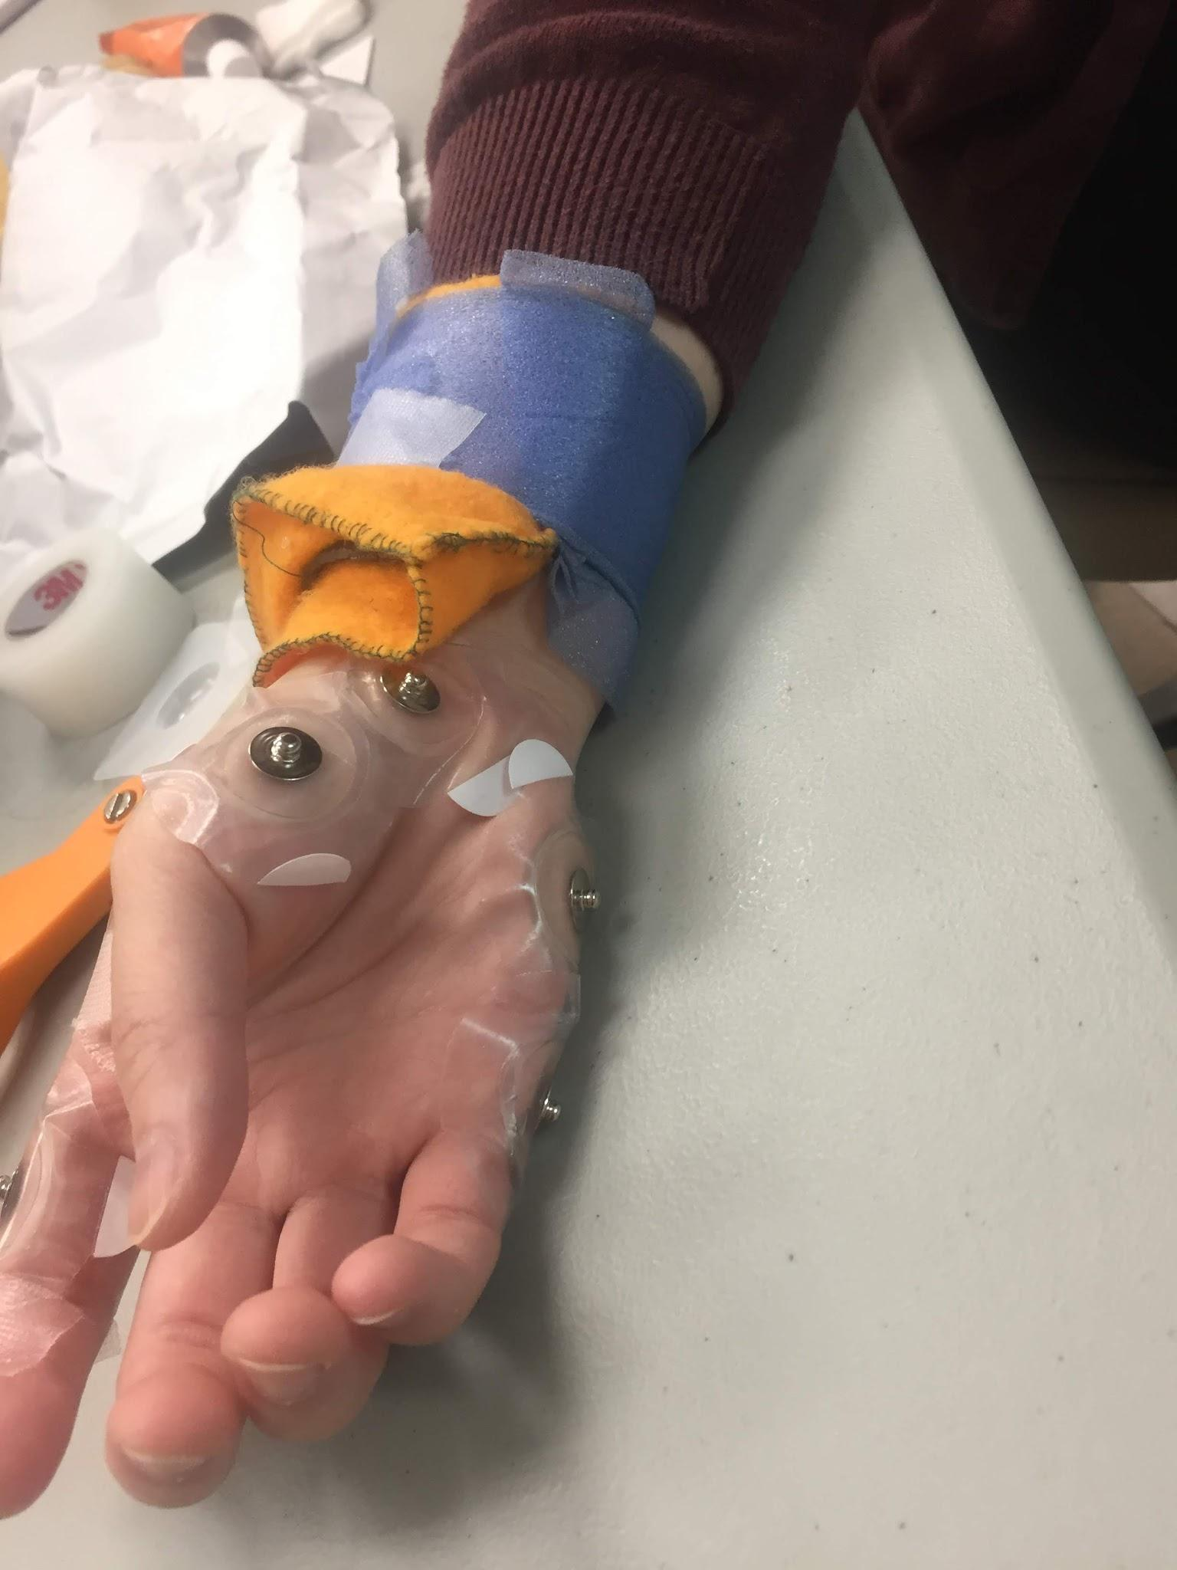
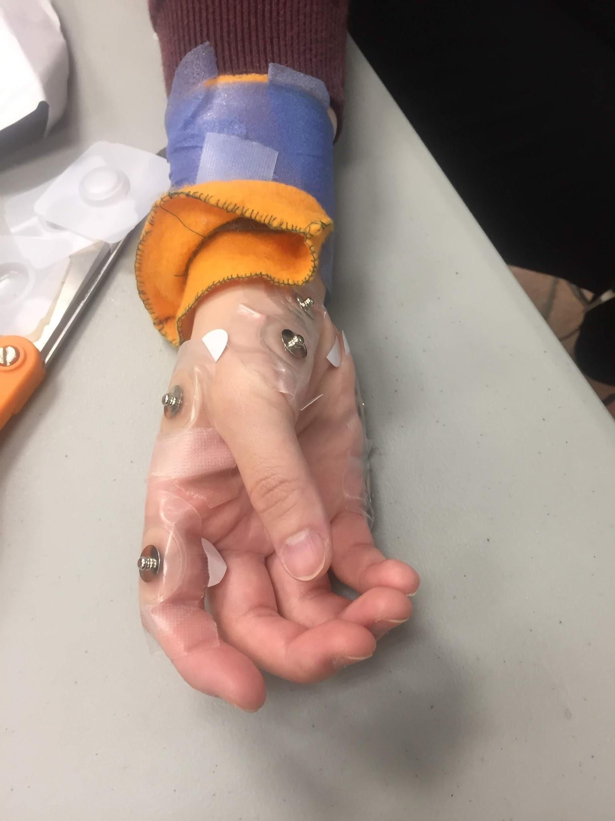
Figure 2. Picture of power grip hand motion, used as squeezing motion for Pre/Post-Testing and to perform training (Baker & Perez, 2017).
Figure 3. Placement of electrodes on hand for Pre and Post-Testing procedures.

Slide 8
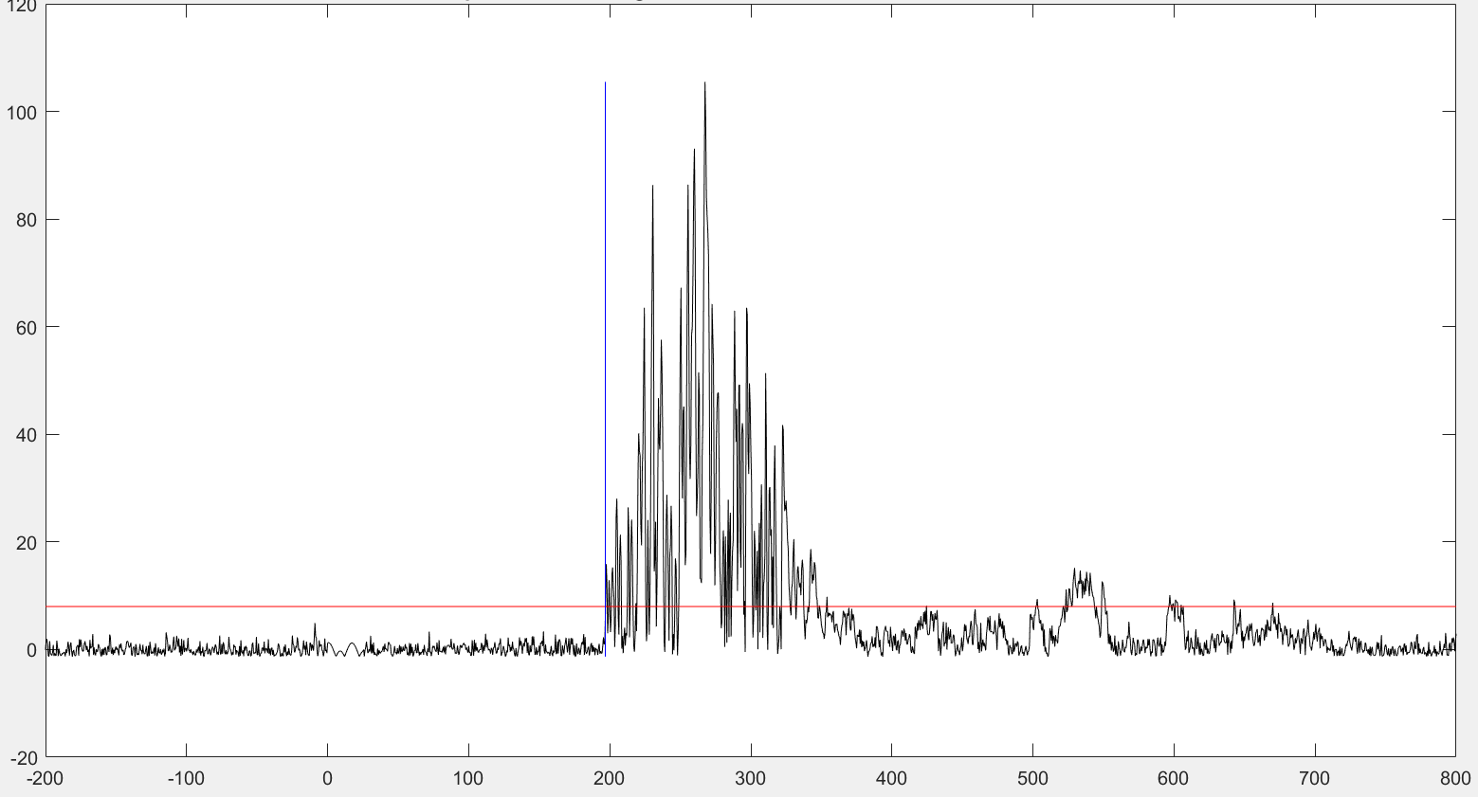
Figure 4. Reaction time of FDI recorded via EMG activity in Spike 2 software. Analysis of instigation of reaction time using Matlab.

Slide 9
Methods- Training
2 Sessions of training were completed 1-2 days apart/not on the same day
Sham Training: 300 repetitions with sham noise (35dB; 500 Hz, 20 ms)
Startle Training: 300 repetitions with startle noise (96.5dB, 500 Hz, 20 ms)
Training order was randomized, sound was delivered with headphones
Training involved moving a blue cylinder to illuminated slots on an engineered board (Figure 5, Figure 6)
Cylinder started on table to begin training and was then moved from its current slot position to the next illuminated position once training was in an ongoing state
Subjects placed their hands on the counter in between each movement
Subjects moved blue cylinder with dominant hand only, and held the cylinder in a power grip when moving it

Slide 10
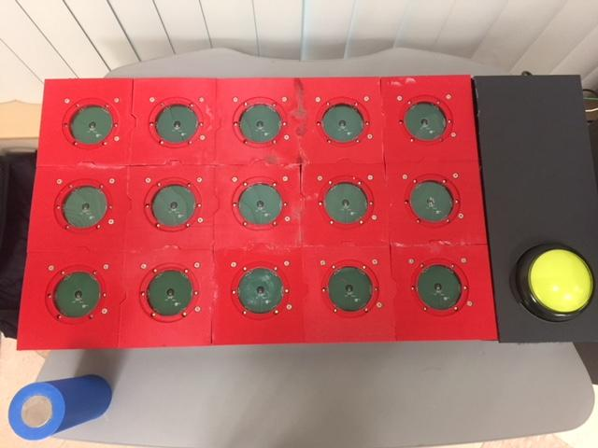
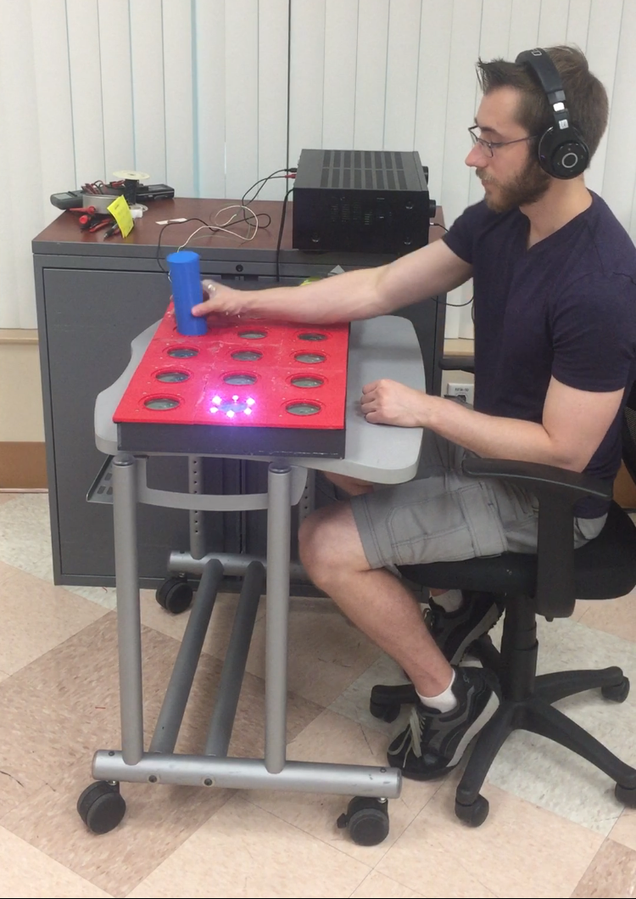
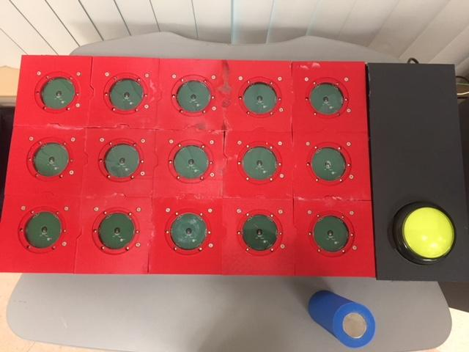
A
B
Figure 6. Subject performing startle training in between testing, and video demonstration.
Figure 5. Set up for training. A) Left-handed set up and B) Right-handed set up

Slide 11
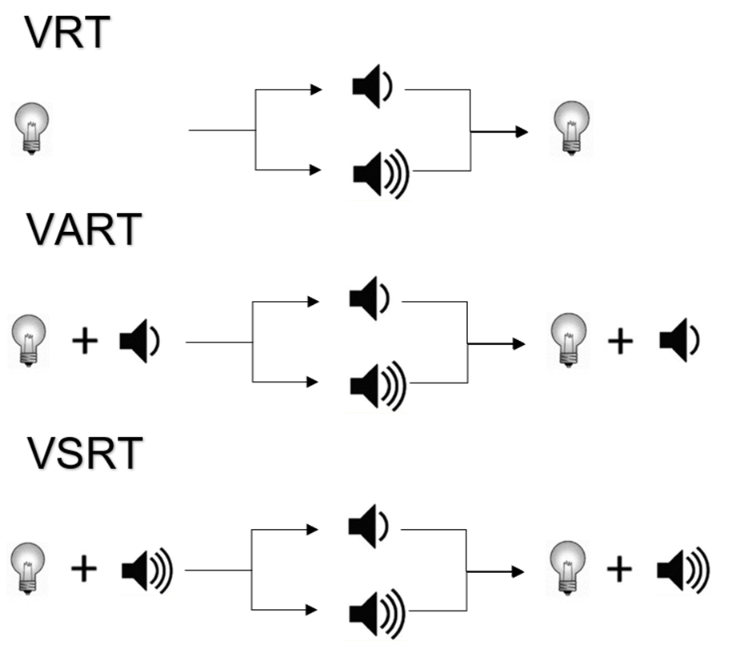
Methods
POST TEST
BASELINE
TRAINING
Figure 7. Schematic of paradigm used in the experimental procedure.
Notes:
General Procedure (Figure 2):
Pre/Post-Test involved surface EMGs looking at the FDI, APB and ADM muscle, with specific emphasis on the FDI
3 conditions were built into the Pre/Post-Test
light only
light + a control sound
light + startle sound
Training sequence that involved object movement with a power grip (Figure 3) with 300 repetitions separated tests.
There were 2 separate sessions of training, one with a sham noise and one with a startle noise.

Slide 12
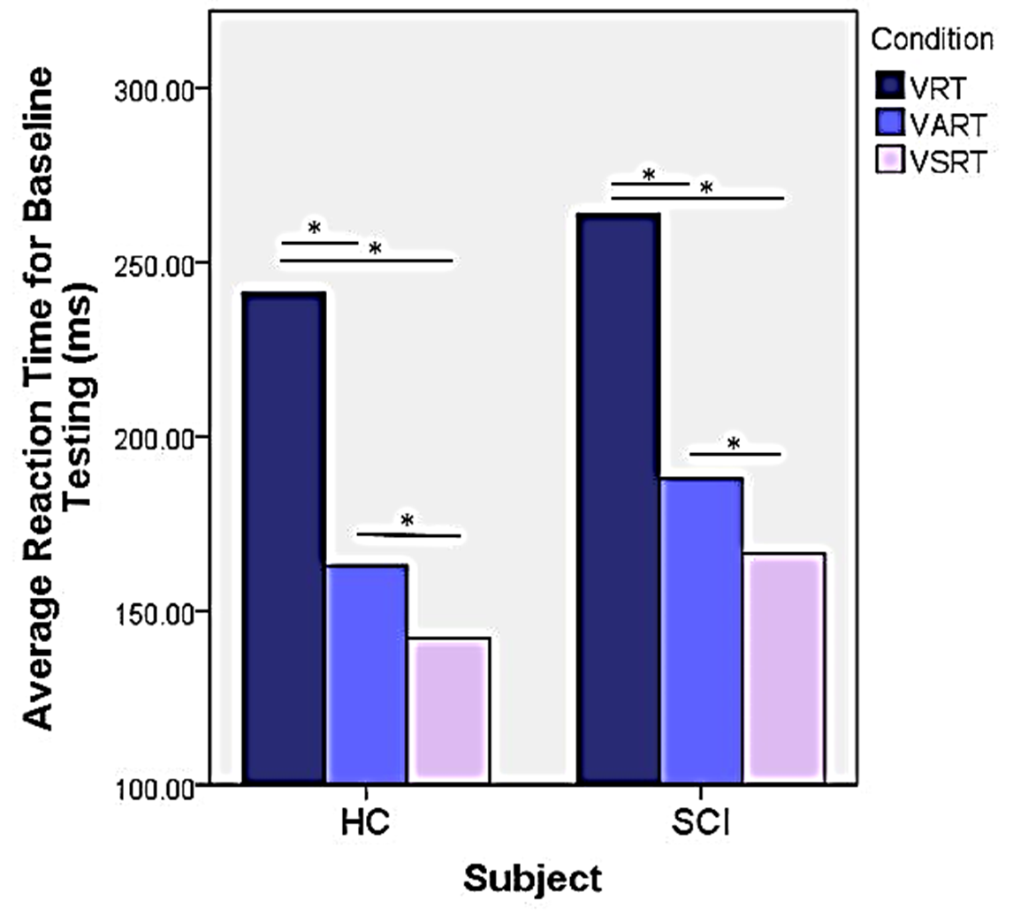
Reaction times are shorter in the VSRT Condition at baseline

Slide 13
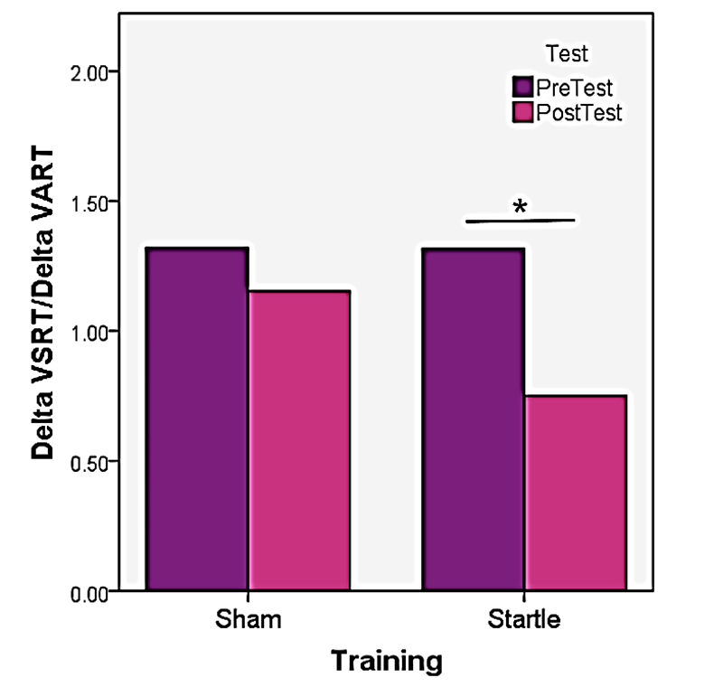
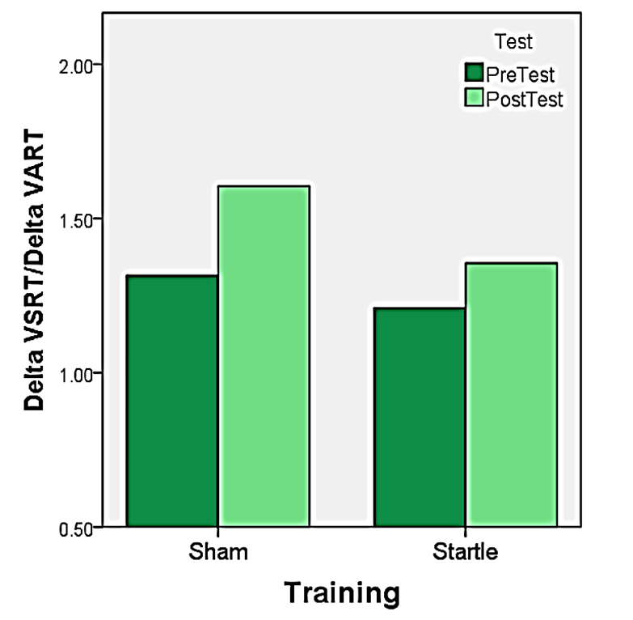
ΔT_{SR}/ΔT_{AR} is lower in control subjects after Startle Training
Controls
SCI

Slide 14
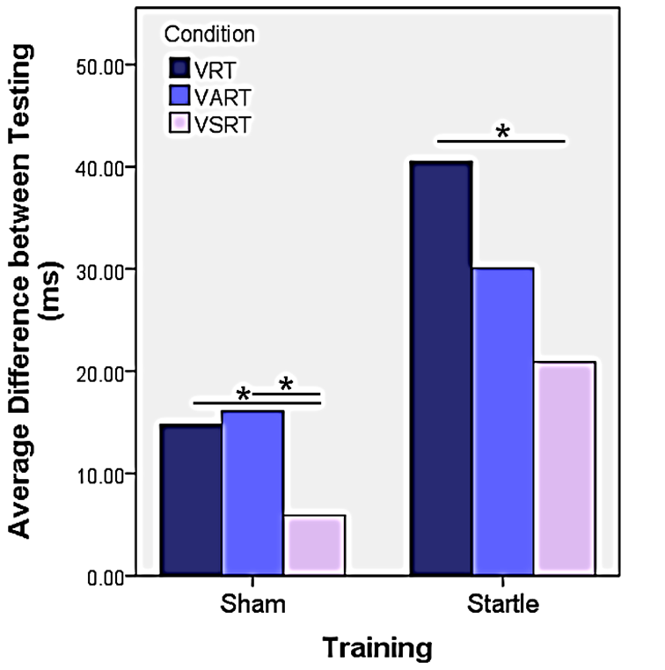
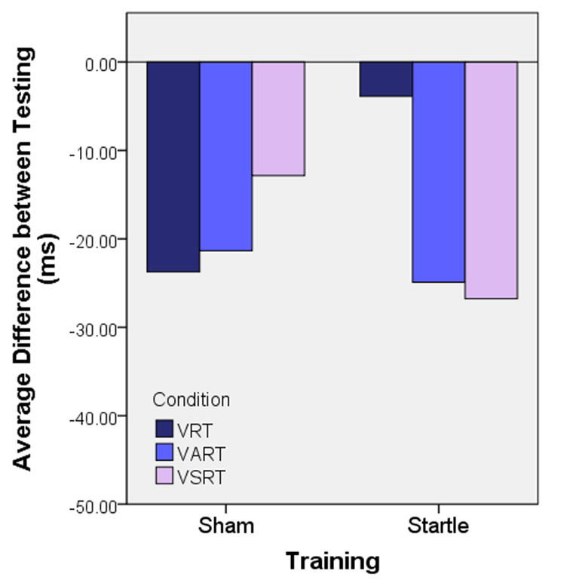
Reaction times are shorter in the VRT compared with VART and VSRT
Controls
SCI

Slide 15
Conclusions and Observations/Suggestions:
The StartReact Response yielded decreased reaction times following a hand training paradigm that utilized gross hand function, indicating reticulospinal involvement.
The most improvement can be seen comparing the testing results of the VRT condition in control subjects.
Maximum reticulospinal effects were seen following the Startle Training in control subjects.
SCI patients did not demonstrate the same degree of improvement
Potential reasons why:
Training is too long, and they are getting tired
**Training protocol might not be long enough**
Future studies will test how to optimize the StartReact paradigm with the gross hand training protocol to maximize reticulospinal effects in humans with SCI.

Slide 16
Acknowledgements
This material is based upon work supported by the National Science Foundation (NSF) under Grant No. CNS-1659144 and the Perez Lab at the Miami Project to Cure Paralysis.
Special Thanks to Dr. Monica A. Perez and everyone at the Perez Lab, particularly Hang Jin Jo and Audrey Wilson. Also, to Dr. Vance Lemmon and Dr. Burt Rosenburg with the University of Miami’s Computing for a Structure Research Experience for Undergraduates (REU).

